Slide 1
REGISTER TRANSFER AND MICRO OPERATIONS
Prepared by-
Prof. Sadhana Sorathiya
Computer Engineering
AITS

Slide 2
REGISTER TRANSFER AND MICROOPERATIONS
Register Transfer & μ-operations
• Register Transfer Language
• Register Transfer
• Bus and Memory Transfers
• Arithmetic Microoperations
• Logic Microoperations
• Shift Microoperations
• Arithmetic Logic Shift Unit

Slide 3
MICROOPERATIONS (1)
Register Transfer & μ-operations
Register Transfer Language
The operations on the data in registers are called microoperations.
The functions built into registers are examples of microoperations
  Shift
  Count
  Clear
  load

Slide 4
ORGANIZATION OF A DIGITAL SYSTEM
Register Transfer & μ-operations
Register Transfer Language
Definition of the (internal) organization of a computer
- Set of registers and their functions
- Microoperations set
Set of allowable microoperations provided
by the organization of the computer
- Control signals that initiate the sequence of
microoperations (to perform the functions)

Slide 5
REGISTER TRANSFER LANGUAGE
Register Transfer & μ-operations
Register Transfer Language
The symbolic notation used to describe the micro operations transfer among registers is called register transfer language
Rather than specifying a digital system in words, a specific notation is used, register transfer language
For any function of the computer, the register transfer language can be used to describe the (sequence of) micro operations.
Register transfer language
  A symbolic language
  A convenient tool for describing the internal organization of digital computers
  Can also be used to facilitate the design process of digital systems.

Slide 6
DESIGNATION OF REGISTERS
Register Transfer & μ-operations
Register Transfer Language
Registers are designated by capital letters, sometimes followed by numbers (e.g., A, R13, IR)
Often the names indicate function:
  MAR - memory address register
  PC - program counter
  IR - instruction register
Registers and their contents can be viewed and represented in various ways
  A register can be viewed as a single entity:
  Registers may also be represented showing the bits of data they contain
MAR

Slide 7
DESIGNATION OF REGISTERS
Register Transfer & μ-operations
Register Transfer Language
Designation of a register
- a register
- portion of a register
- a bit of a register
Common ways of drawing the block diagram of a register
Register
Showing individual bits
R1
7 6 5 4 3 2 1 0
15
0
15
8
7
0
R2
PC(H)
PC(L)
Numbering of bits
Subfields

Slide 8
REGISTER TRANSFER
Register Transfer & μ-operations
Register Transfer
Copying the contents of one register to another is a register transfer
A register transfer is indicated as
  R2 ← R1
  In this case the contents of register R2 are copied (loaded) into register R1
  A simultaneous transfer of all bits from the source R1 to the destination register R2, during one clock pulse
  Note that this is a non-destructive; i.e. the contents of R1 are not altered by copying (loading) them to R2

Slide 9
CONTROL FUNCTIONS
Register Transfer & μ-operations
Register Transfer
Often actions need to only occur if a certain condition is true
This is similar to an “if” statement in a programming language
In digital systems, this is often done via a control signal, called a control function
  If the signal is 1, the action takes place
This is represented as:
  P: R2 ← R1
  Which means “if P = 1, then load the contents of register R1 into register R2”, i.e., if (P = 1) then (R2 ← R1)

Slide 10
HARDWARE IMPLEMENTATION OF CONTROLLED TRANSFERS
Register Transfer & μ-operations
Register Transfer
Implementation of controlled transfer
P: R2 ← R1
Block diagram
Control
Circuit
P
Load
R2
Clock
n
R1
Timing diagram
t
t+1
Clock
Load
Transfer occurs here
The same clock controls the circuits that generate the control function
and the destination register
Registers are assumed to use positive-edge-triggered flip-flops

Slide 11
SIMULTANEOUS OPERATIONS
Register Transfer & μ-operations
Register Transfer
If two or more operations are to occur simultaneously, they are separated with commas
  P: R3 ← R5, MAR ← IR
Here, if the control function P = 1, load the contents of R5 into R3, and at the same time (clock), load the contents of register IR into register MAR

Slide 12
BASIC SYMBOLS FOR REGISTER TRANSFERS
Register Transfer & μ-operations
Register Transfer
Symbols
Description Examples
Capital letters Denotes a register MAR, R2
& numerals
Parentheses () Denotes a part of a register R2(0-7), R2(L)
Arrow ← Denotes transfer of information R2 ← R1
Colon : Denotes termination of control function P:
Comma , Separates two micro-operations A ← B, B ← A

Slide 13
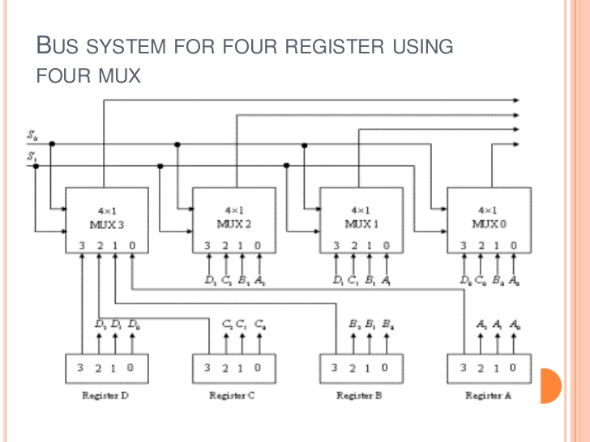
BUS AND Memory TRANSFER
Register Transfer & μ-operations
Bus and Memory Transfers
Bus is a path(of a group of wires) over which information is transferred, from any of several sources to any of several destinations.
From a register to bus: BUS ← R

Slide 14
TRANSFER FROM BUS TO A DESTINATION REGISTER
Register Transfer & μ-operations
Bus and Memory Transfers
Three-State Bus Buffers
Normal input A
Output Y=A if C=1
High-impedence if C=0
Control input C
Bus line with three-state buffers
Bus line for bit 0
A0
B0
C0
D0
S0
0
Select
S1
1
2
Enable
3

Slide 15
BUS TRANSFER IN RTL
Register Transfer & μ-operations
Bus and Memory Transfers
Symbolic statement for bus transfer may mention bus
Register transfer is symbolized
Content of c loaded to bus and content of bus loaded into register R1.
BUS← C
R1 ← BUS

Slide 16
MEMORY (RAM)
Register Transfer & μ-operations
Bus and Memory Transfers
Memory (RAM) can be thought as a sequential circuits containing some number of registers
These registers hold the words of memory
Each of the r registers is indicated by an address
These addresses range from 0 to r-1
Each register (word) can hold n bits of data
Assume the RAM contains r = 2k words. It needs the following
  n data input lines
  n data output lines
  k address lines
  A Read control line
  A Write control line
data input lines
n
address lines
k
RAM
unit
Read
Write
n
data output lines

Slide 17
MEMORY TRANSFER
Register Transfer & μ-operations
Bus and Memory Transfers
Collectively, the memory is viewed at the register level as a device, M.
Since it contains multiple locations, we must specify which address in memory we will be using
This is done by indexing memory references
Memory is usually accessed in computer systems by putting the desired address in a special register, the Memory Address Register (MAR, or AR)
When memory is accessed, the contents of the MAR get sent to the memory unit’s address lines
M
Memory
unit
Read
AR
Write
Data out
Data in

Slide 18
MEMORY READ
Register Transfer & μ-operations
Bus and Memory Transfers
To read a value from a location in memory and load it into a register, the register transfer language notation looks like this:
This causes the following to occur
  The contents of the MAR get sent to the memory address lines
  A Read (= 1) gets sent to the memory unit
  The contents of the specified address are put on the memory’s output data lines
  These get sent over the bus to be loaded into register R1
R1 ← M[MAR]

Slide 19
MEMORY WRITE
Register Transfer & μ-operations
Bus and Memory Transfers
To write a value from a register to a location in memory looks like this in register transfer language:
This causes the following to occur
  The contents of the MAR get sent to the memory address lines
  A Write (= 1) gets sent to the memory unit
  The values in register R1 get sent over the bus to the data input lines of the memory
  The values get loaded into the specified address in the memory
M[MAR] ← R1

Slide 20
SUMMARY OF R. TRANSFER MICROOPERATIONS
Register Transfer & μ-operations
Bus and Memory Transfers
A ← B Transfer content of reg. B into reg. A
AR ← DR(AD) Transfer content of AD portion of reg. DR into reg. AR
A ← constant Transfer a binary constant into reg. A
ABUS ← R1, Transfer content of R1 into bus A and, at the same time,
R2 ← ABUS transfer content of bus A into R2
AR Address register
DR Data register
M[R] Memory word specified by reg. R
M Equivalent to M[AR]
DR ← M Memory read operation: transfers content of
memory word specified by AR into DR
M ← DR Memory write operation: transfers content of
DR into memory word specified by AR

Slide 21
MICROOPERATIONS
Register Transfer & μ-operations
Arithmetic Microoperations
Computer system microoperations are of four types:
- Register transfer microoperations
- Arithmetic microoperations
- Logic microoperations
- Shift microoperations

Slide 22
ARITHMETIC MICROOPERATIONS
Register Transfer & μ-operations
Arithmetic Microoperations
The basic arithmetic microoperations are
  Addition
  Subtraction
  Increment
  Decrement
The additional arithmetic microoperations are
  Add with carry
  Subtract with borrow
  Transfer/Load
  etc. …
Summary of Typical Arithmetic Micro-Operations
  R3 ← R1 + R2 Contents of R1 plus R2 transferred to R3
  R3 ← R1 - R2 Contents of R1 minus R2 transferred to R3
  R2 ← R2’ Complement the contents of R2
  R2 ← R2’+ 1 2's complement the contents of R2 (negate)
  R3 ← R1 + R2’+ 1 subtraction
  R1 ← R1 + 1 Increment
  R1 ← R1 - 1 Decrement

Slide 23
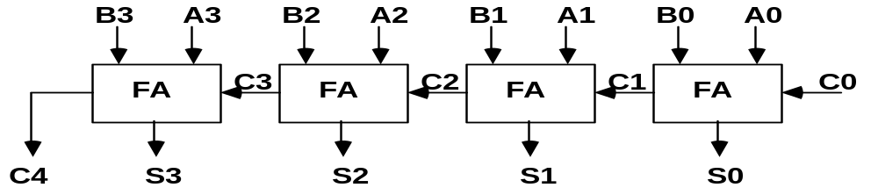
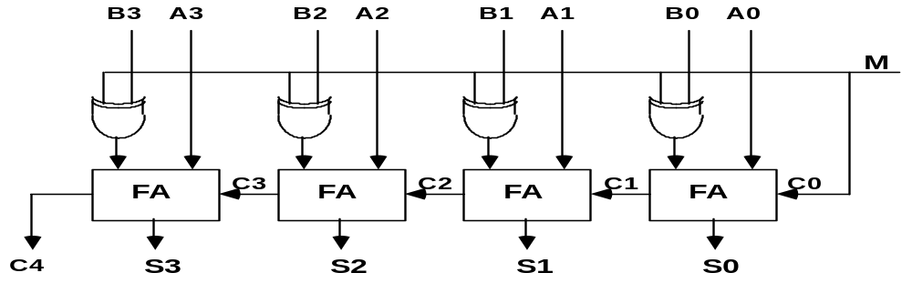
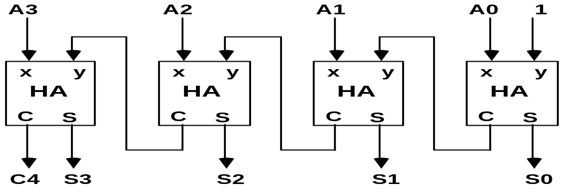
BINARY ADDER / SUBTRACTOR / INCREMENTER
Register Transfer & μ-operations
Arithmetic Microoperations
Binary Adder
Binary Adder-Subtractor
Binary Incrementer

Slide 24
ARITHMETIC CIRCUIT
Register Transfer & μ-operations
Arithmetic Microoperations
Cin
S1
S0
A0
X0
C0
S1
FA
D0
B0
S0
4x1
Y0
C1
0
1
MUX
2
3
A1
X1
C1
S1
FA
D1
B1
S0
4x1
Y1
C2
0
1
MUX
2
3
A2
X2
C2
S1
FA
D2
B2
S0
4x1
Y2
C3
0
1
MUX
2
3
A3
X3
C3
S1
FA
D3
B3
S0
4x1
Y3
C4
0
1
MUX
2
Cout
0
1
3
S1 S0 Cin Y Output Microoperation
0 0 0 B D = A + B Add
0 0 1 B D = A + B + 1 Add with carry
0 1 0 B’ D = A + B’ Subtract with borrow
0 1 1 B’ D = A + B’+ 1 Subtract
1 0 0 0 D = A Transfer A
1 0 1 0 D = A + 1 Increment A
1 1 0 1 D = A - 1 Decrement A
1 1 1 1 D = A Transfer A

Slide 25
LOGIC MICROOPERATIONS
Register Transfer & μ-operations
Logic Microoperations
Specify binary operations on the strings of bits in registers
  Logic microoperations are bit-wise operations, i.e., they work on the individual bits of data
  useful for bit manipulations on binary data
  useful for making logical decisions based on the bit value
There are, in principle, 16 different logic functions that can be defined over two binary input variables
However, most systems only implement four of these
  AND (∧), OR (∨), XOR (⊕), Complement/NOT
The others can be created from combination of these
A B F₀ F₁ F₂ … F₁₃ F₁₄ F₁₅
0 0 0 0 0 … 1 1 1
0 1 0 0 0 … 1 1 1
1 0 0 0 1 … 0 1 1
1 1 0 1 0 … 1 0 1

Slide 26
LIST OF LOGIC MICROOPERATIONS
Register Transfer & μ-operations
Logic Microoperations
List of Logic Microoperations
- 16 different logic operations with 2 binary vars.
- n binary vars → functions
2
2
n
Truth tables for 16 functions of 2 variables and the
corresponding 16 logic micro-operations
x 0 0 1 1
y 0 1 0 1
Boolean
Function
Micro-
Operations
Name
  0 0 0 0 F0 = 0 F ← 0 Clear
  0 0 0 1 F1 = xy F ← A ∧ B AND
  0 0 1 0 F2 = xy' F ← A ∧ B’
  0 0 1 1 F3 = x F ← A Transfer A
  0 1 0 0 F4 = x'y F ← A’∧ B
  0 1 0 1 F5 = y F ← B Transfer B
  0 1 1 0 F6 = x ⊕ y F ← A ⊕ B Exclusive-OR
  0 1 1 1 F7 = x + y F ← A ∨ B OR
  1 0 0 0 F8 = (x + y)' F ← (A ∨ B)’ NOR
  1 0 0 1 F9 = (x ⊕ y)' F ← (A ⊕ B)’ Exclusive-NOR
  1 0 1 0 F10 = y' F ← B’ Complement B
  1 0 1 1 F11 = x + y' F ← A ∨ B
  1 1 0 0 F12 = x' F ← A’ Complement A
  1 1 0 1 F13 = x' + y F ← A’∨ B
  1 1 1 0 F14 = (xy)' F ← (A ∧ B)’ NAND
  1 1 1 1 F15 = 1 F ← all 1's Set to all 1's

Slide 27
HARDWARE IMPLEMENTATION OF LOGIC MICROOPERATIONS
Register Transfer & μ-operations
Logic Microoperations
A
i
0
B
i
1
4 X 1
F
MUX
i
2
3
Select
S
1
S
0
Function table
S₁ S₀
Output
μ-operation
0 0 F = A ∧ B AND
0 1 F = A ∨ B OR
1 0 F = A ⊕ B XOR
1 1 F = A’ Complement

Slide 28
APPLICATIONS OF LOGIC MICROOPERATIONS
Register Transfer & μ-operations
Logic Microoperations
Logic microoperations can be used to manipulate individual bits or a portions of a word in a register
Consider the data in a register A. In another register, B, is bit data that will be used to modify the contents of A
  Selective-set A ← A + B
  Selective-complement A ← A ⊕ B
  Selective-clear A ← A • B’
  Mask (Delete) A ← A • B
  Clear A ← A ⊕ B
  Insert A ← (A • B) + C
  Compare A ← A ⊕ B
  . . .

Slide 29
SELECTIVE SET
Register Transfer & μ-operations
Logic Microoperations
In a selective set operation, the bit pattern in B is used to set certain bits in A
1 1 0 0 A_{t}
1 0 1 0 B
1 1 1 0 A_{t+1} (A ← A + B)
If a bit in B is set to 1, that same position in A gets set to 1, otherwise that bit in A keeps its previous value

Slide 30
SELECTIVE COMPLEMENT
Register Transfer & μ-operations
Logic Microoperations
In a selective complement operation, the bit pattern in B is used to complement certain bits in A
1 1 0 0 A_{t}
1 0 1 0 B
0 1 1 0 A_{t+1} (A ← A ⊕ B)
If a bit in B is set to 1, that same position in A gets complemented from its original value, otherwise it is unchanged

Slide 31
SELECTIVE CLEAR
Register Transfer & μ-operations
Logic Microoperations
In a selective clear operation, the bit pattern in B is used to clear certain bits in A
1 1 0 0 A_{t}
1 0 1 0 B
0 1 0 0 A_{t+1} (A ← A ⋅ B’)
If a bit in B is set to 1, that same position in A gets set to 0, otherwise it is unchanged

Slide 32
MASK OPERATION
Register Transfer & μ-operations
Logic Microoperations
In a mask operation, the bit pattern in B is used to clear certain bits in A
1 1 0 0 A_{t}
1 0 1 0 B
1 0 0 0 A_{t+1} (A ← A ⋅ B)
If a bit in B is set to 0, that same position in A gets set to 0, otherwise it is unchanged

Slide 33
CLEAR OPERATION
Register Transfer & μ-operations
Logic Microoperations
In a clear operation, if the bits in the same position in A and B are the same, they are cleared in A, otherwise they are set in A
1 1 0 0 A_{t}
1 0 1 0 B
0 1 1 0 A_{t+1} (A ← A ⊕ B)

Slide 34
INSERT OPERATION
Register Transfer & μ-operations
Logic Microoperations
An insert operation is used to introduce a specific bit pattern into A register, leaving the other bit positions unchanged
This is done as
  A mask operation to clear the desired bit positions, followed by
  An OR operation to introduce the new bits into the desired positions
  Example
    Suppose you wanted to introduce 1010 into the low order four bits of A: 1101 1000 1011 0001 A (Original) 1101 1000 1011 1010 A (Desired)
    1101 1000 1011 0001 A (Original)
    1111 1111 1111 0000 Mask
    1101 1000 1011 0000 A (Intermediate)
    0000 0000 0000 1010 Added bits
    1101 1000 1011 1010 A (Desired)

Slide 35
SHIFT MICROOPERATIONS
Register Transfer & μ-operations
Shift Microoperations
There are three types of shifts
  Logical shift
  Circular shift
  Arithmetic shift
What differentiates them is the information that goes into the serial input
A right shift operation
A left shift operation
Serial
input
Serial
input

Slide 36
LOGICAL SHIFT
Register Transfer & μ-operations
Shift Microoperations
In a logical shift the serial input to the shift is a 0.
A right logical shift operation:
A left logical shift operation:
In a Register Transfer Language, the following notation is used
  shl for a logical shift left
  shr for a logical shift right
  Examples:
    R2 ← shr R2
    R3 ← shl R3
0
0

Slide 37
CIRCULAR SHIFT
Register Transfer & μ-operations
Shift Microoperations
In a circular shift the serial input is the bit that is shifted out of the other end of the register.
A right circular shift operation:
A left circular shift operation:
In a RTL, the following notation is used
  cil for a circular shift left
  cir for a circular shift right
  Examples:
    R2 ← cir R2
    R3 ← cil R3

Slide 38
ARITHMETIC SHIFT
Register Transfer & μ-operations
Shift Microoperations
An arithmetic shift is meant for signed binary numbers (integer)
An arithmetic left shift multiplies a signed number by two
An arithmetic right shift divides a signed number by two
The main distinction of an arithmetic shift is that it must keep the sign of the number the same as it performs the multiplication or division
A right arithmetic shift operation:
A left arithmetic shift operation:
sign
bit
0
sign
bit

Slide 39
ARITHMETIC SHIFT
Register Transfer & μ-operations
Shift Microoperations
An left arithmetic shift operation must be checked for the overflow
0
sign
bit
Before the shift, if the leftmost two
bits differ, the shift will result in an
overflow
V
In a RTL, the following notation is used
  ashl for an arithmetic shift left
  ashr for an arithmetic shift right
  Examples:
    R2 ← ashr R2
    R3 ← ashl R3

Slide 40
HARDWARE IMPLEMENTATION OF SHIFT MICROOPERATIONS
Register Transfer & μ-operations
Shift Microoperations
Serial
input (I_{R})
Select
0 for shift right (down)
1 for shift left (up)
S
H0
0
MUX
1
A0
A1
S
H1
0
MUX
A2
1
A3
S
0
MUX
H2
1
S
H3
0
MUX
1
Serial
input (I_{L})

Slide 41
ARITHMETIC LOGIC SHIFT UNIT
Register Transfer & μ-operations
Shift Microoperations
S3
S2
C
S1
i
S0
D
Arithmetic
i
Circuit
Select
C
0
4 x 1
F
i+1
1
MUX
i
2
3
Logic
E
B
i
i
Circuit
A
i
shr
A
i-1
shl
A
i+1
  S3 S2 S1 S0 Cin Operation Function
  0 0 0 0 0 F = A Transfer A
  0 0 0 0 1 F = A + 1 Increment A
  0 0 0 1 0 F = A + B Addition
  0 0 0 1 1 F = A + B + 1 Add with carry
  0 0 1 0 0 F = A + B’ Subtract with borrow
  0 0 1 0 1 F = A + B’+ 1 Subtraction
  0 0 1 1 0 F = A - 1 Decrement A
  0 0 1 1 1 F = A TransferA
  0 1 0 0 X F = A ∧ B AND
  0 1 0 1 X F = A ∨ B OR
  0 1 1 0 X F = A ⊕ B XOR
  0 1 1 1 X F = A’ Complement A
  1 0 X X X F = shr A Shift right A into F
  1 1 X X X F = shl A Shift left A into F

